Slide 1
Fekete lyukak és a gravitációs hullámok

Slide 2
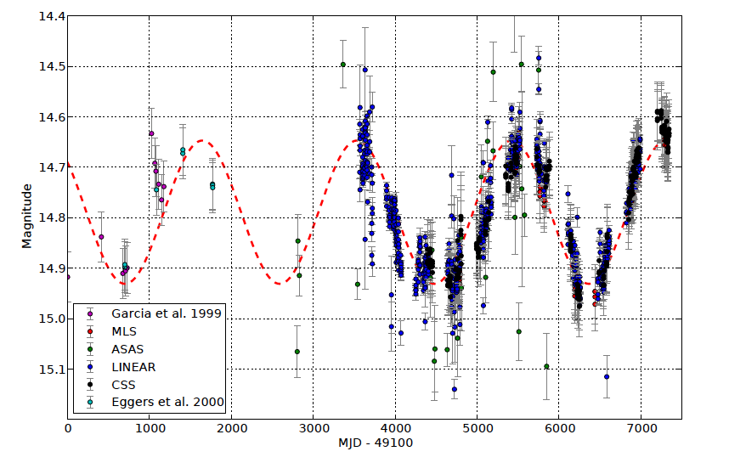
PG 1302-102: periódus 5.2 év
~
Graham et al. arXiv: 1501.013

Slide 3
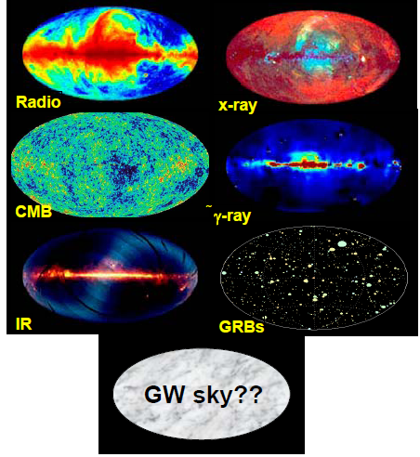
A new window on the Universe
EXPECT THE UNEXPECTED!
Notes:
The observation of GW offers an exciting new opportunity to study the universe. GWs are much different than all other forms of radiation. Carry direct information on the structure of spacetime, can … We are desperately waiting to see this new window open up in the near future, and will be very exciting to discover what it reveals.

Slide 4
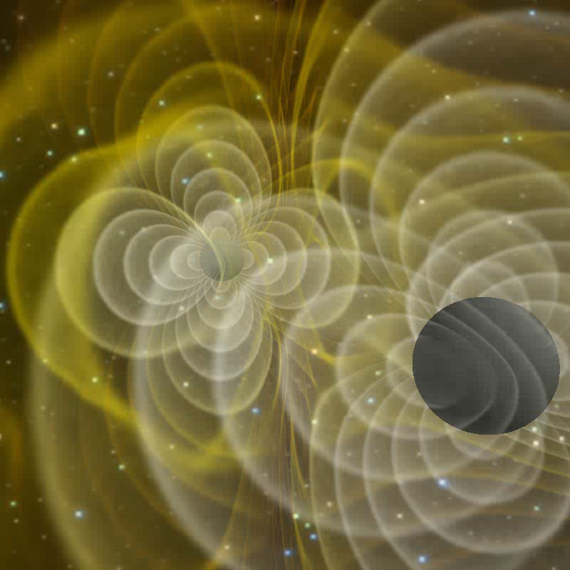
Gravitációs hullámok
(Centrella et al. 2007)

Slide 5



Gravitációs hullámok
Gravitációs hullámok = téridő disztorzió
Fénysebességgel terjed
Relatív megnyúlás
Távolsággal 1/r szerint csökken
Két polarizáció

Slide 6
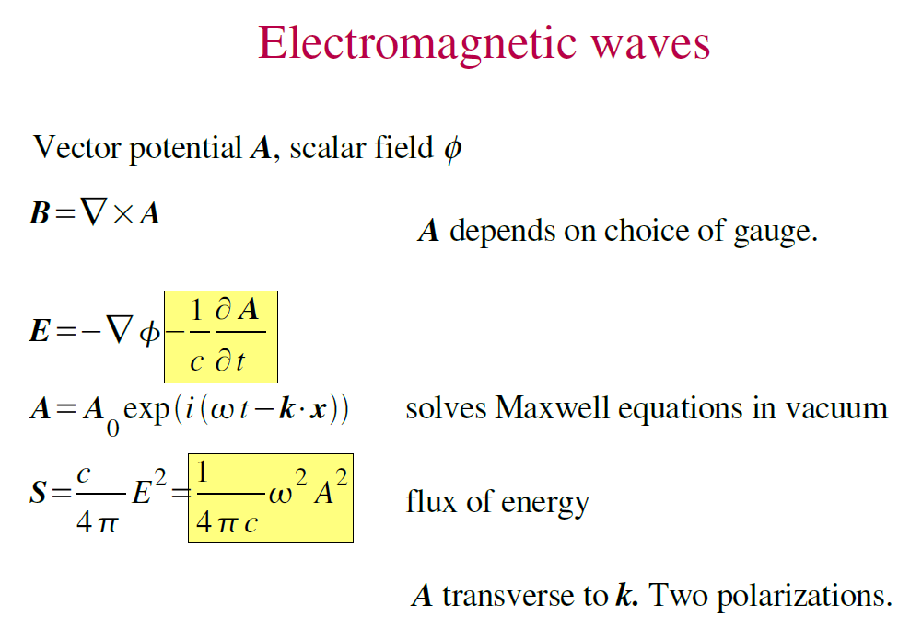

Slide 8
What you need to remember

Slide 10
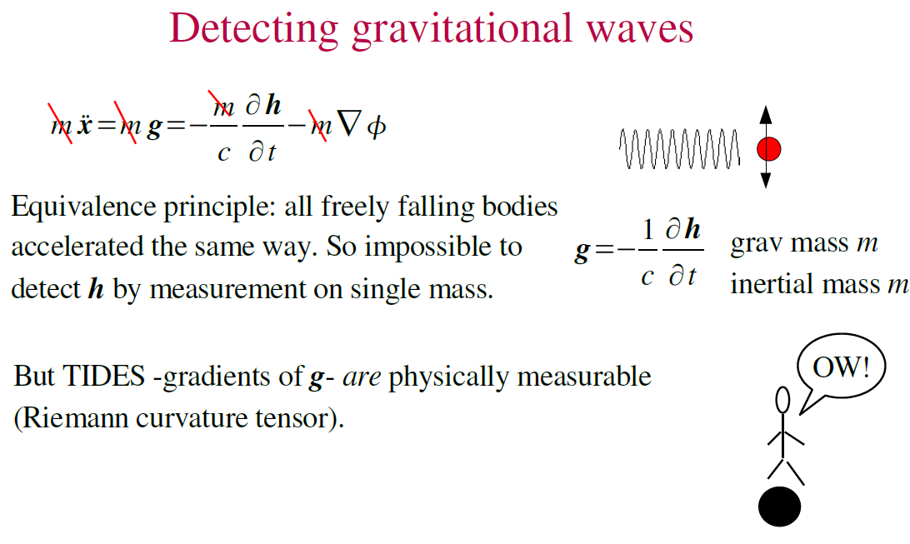

Slide 13
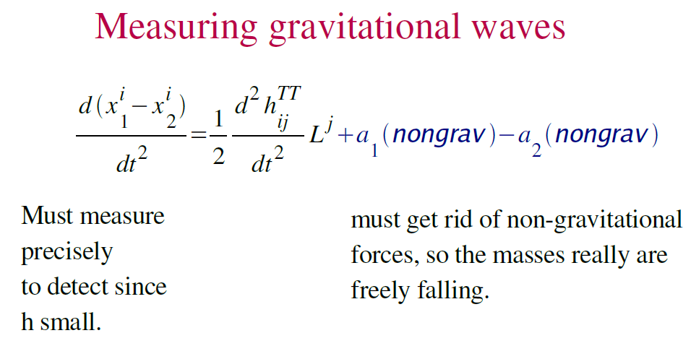

Slide 14
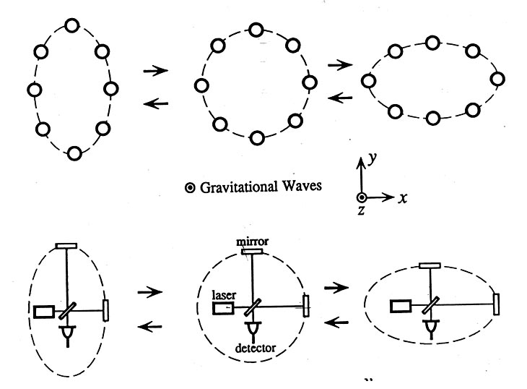
Measuring Gravitational-waves
free masses
Michelson-type laser interferometer (LIGO, VIRGO, GEO, TAMA)
Notes:
In order to measure GWs from known astrophysical sources, we need an instrument capable of measuring distances to an extreme relative precision. The mission concept is …cavities arms suspended masses

Slide 15
Interferometry for LISA

Slide 16
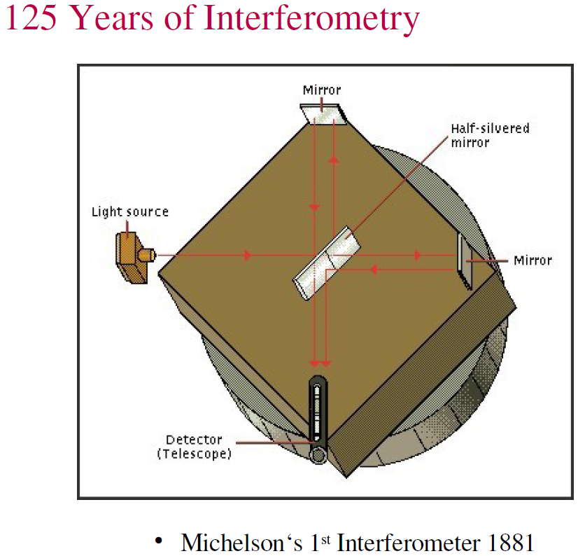

Slide 19
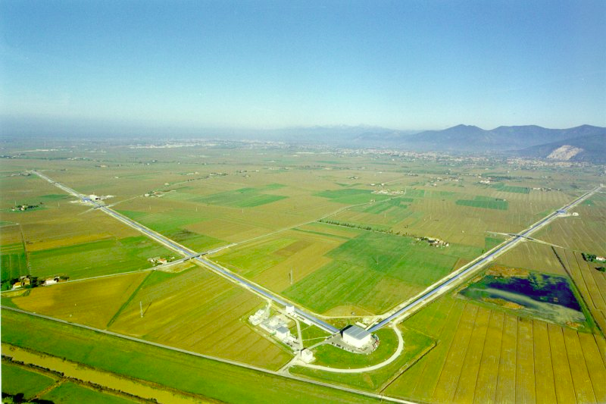
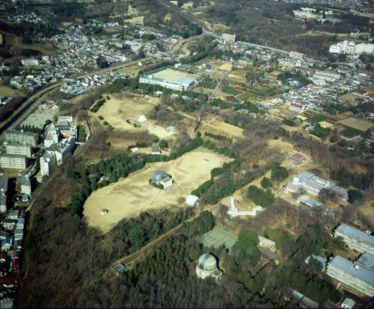
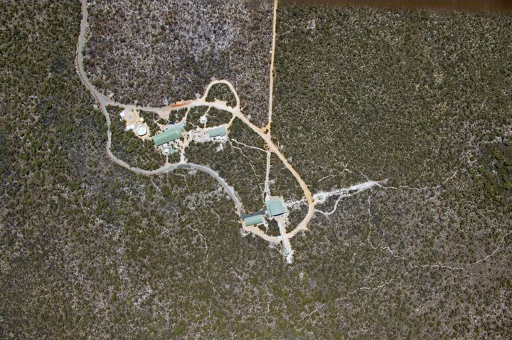
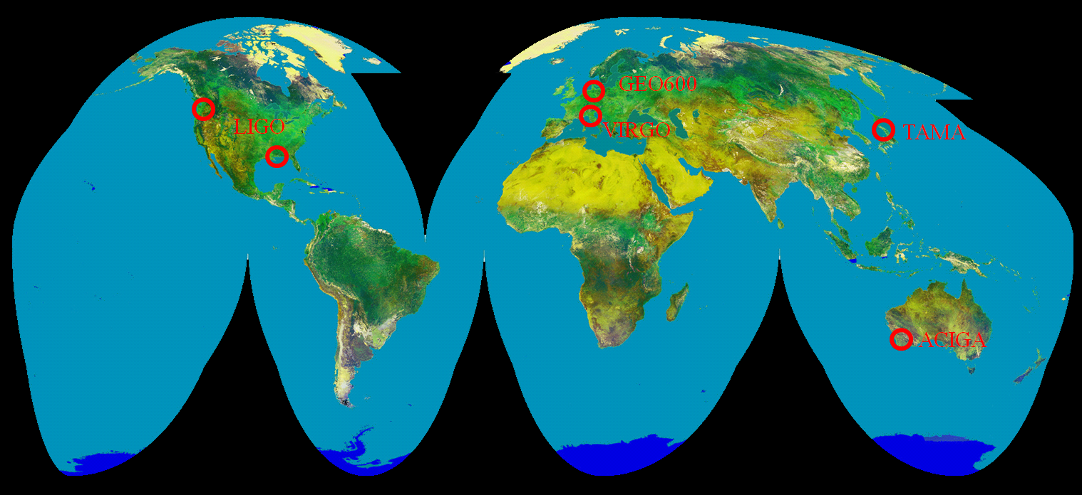
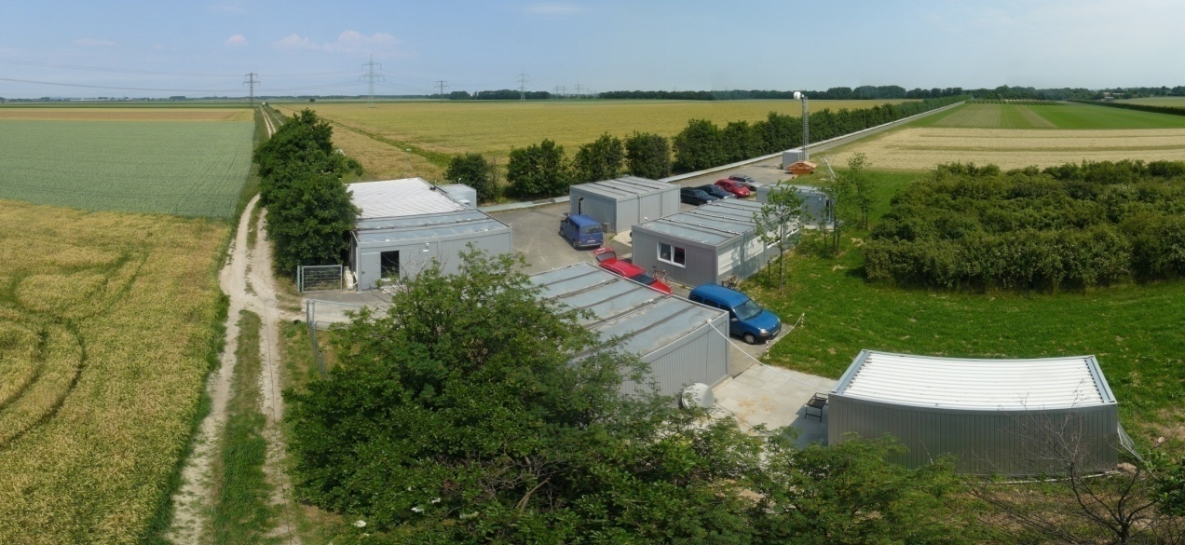
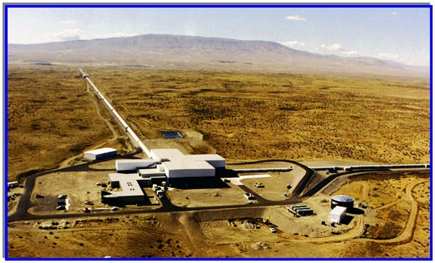
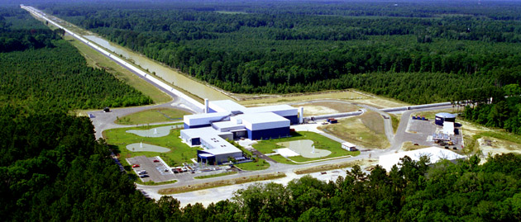
A World-wide interferometer network
Virgo
AIGO
TAMA300
GEO600
LIGO
Livingston
LIGO
Hanford
LIGO
Livingston

Slide 20
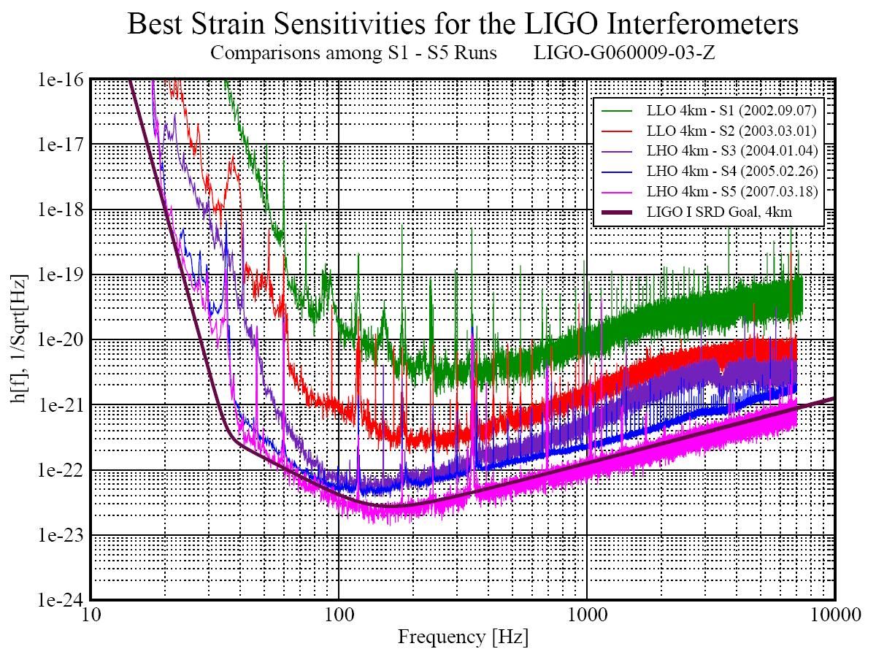
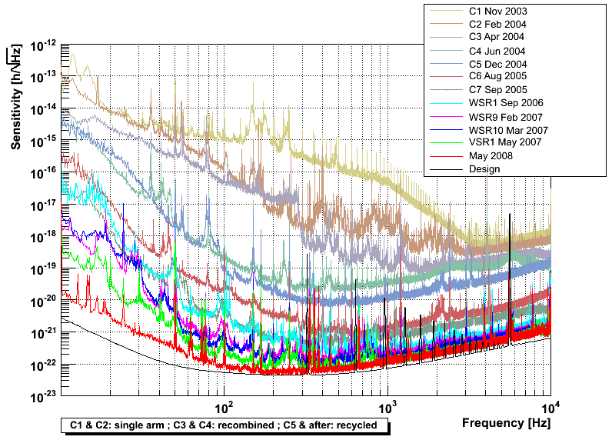
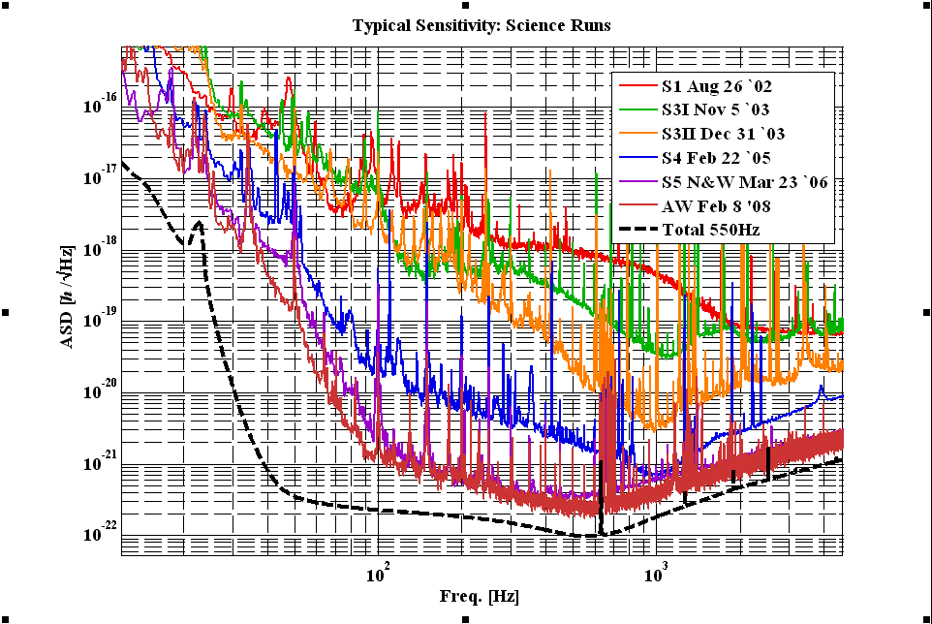
LIGO
Virgo
GEO600
All large detectors have come close to or even exceeded design sensitivity

Slide 21
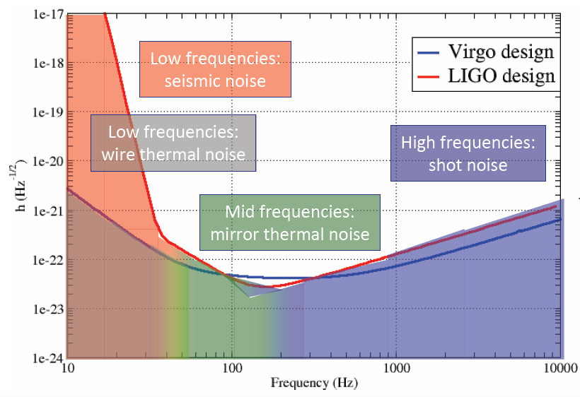
Second Generation instruments
Factor 10 improvement in sensitivity
  Advanced LIGO, Advanced VIRGO, LCGT

Slide 22
1st generation
2nd generation
3rd generation
10²
Credit: M. Punturo, G. Losurdo

Slide 23
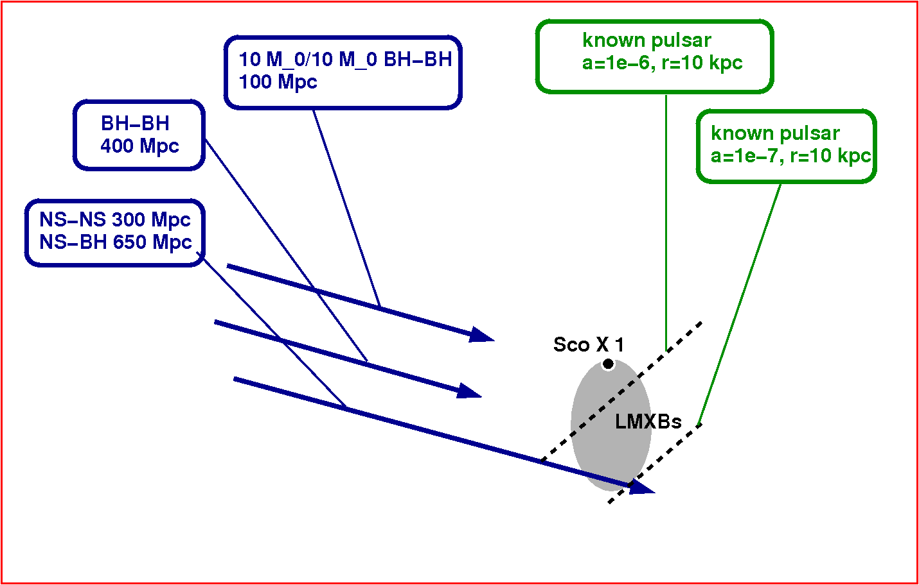
1st generation
2nd generation
3rd generation

Slide 24
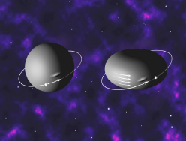
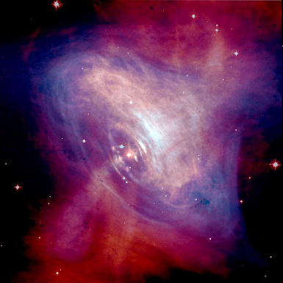
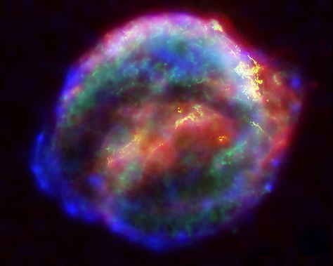
Sources for LIGO
Compact binary inspirals
pulsars
Supernovae, GRBs
chirps
continuous
bursts

Slide 25
Frequency at last stable orbit
→ detectable mass range
10000
Primordial binary black holes
Binary neutron stars
Binary black holes
Neutron star-black hole binaries
Extreme mass ratio inspirals
Intermediate black hole binaries
1000
1 Hz
10 Hz
Mass M
100
IBBH
10
BBH
EMRIs
1
BNS
NS-BH
PBBH
0.1
Mass M
100
0.1
1
10
1000
10000
Courtesy Sathyaprakash

Slide 26
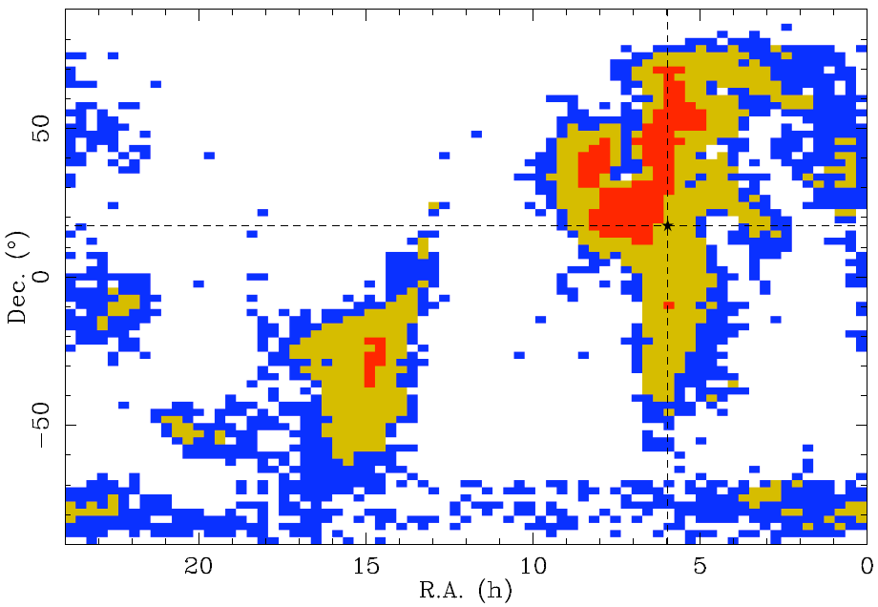
Inspirals + Ringdowns present LIGO

Slide 27
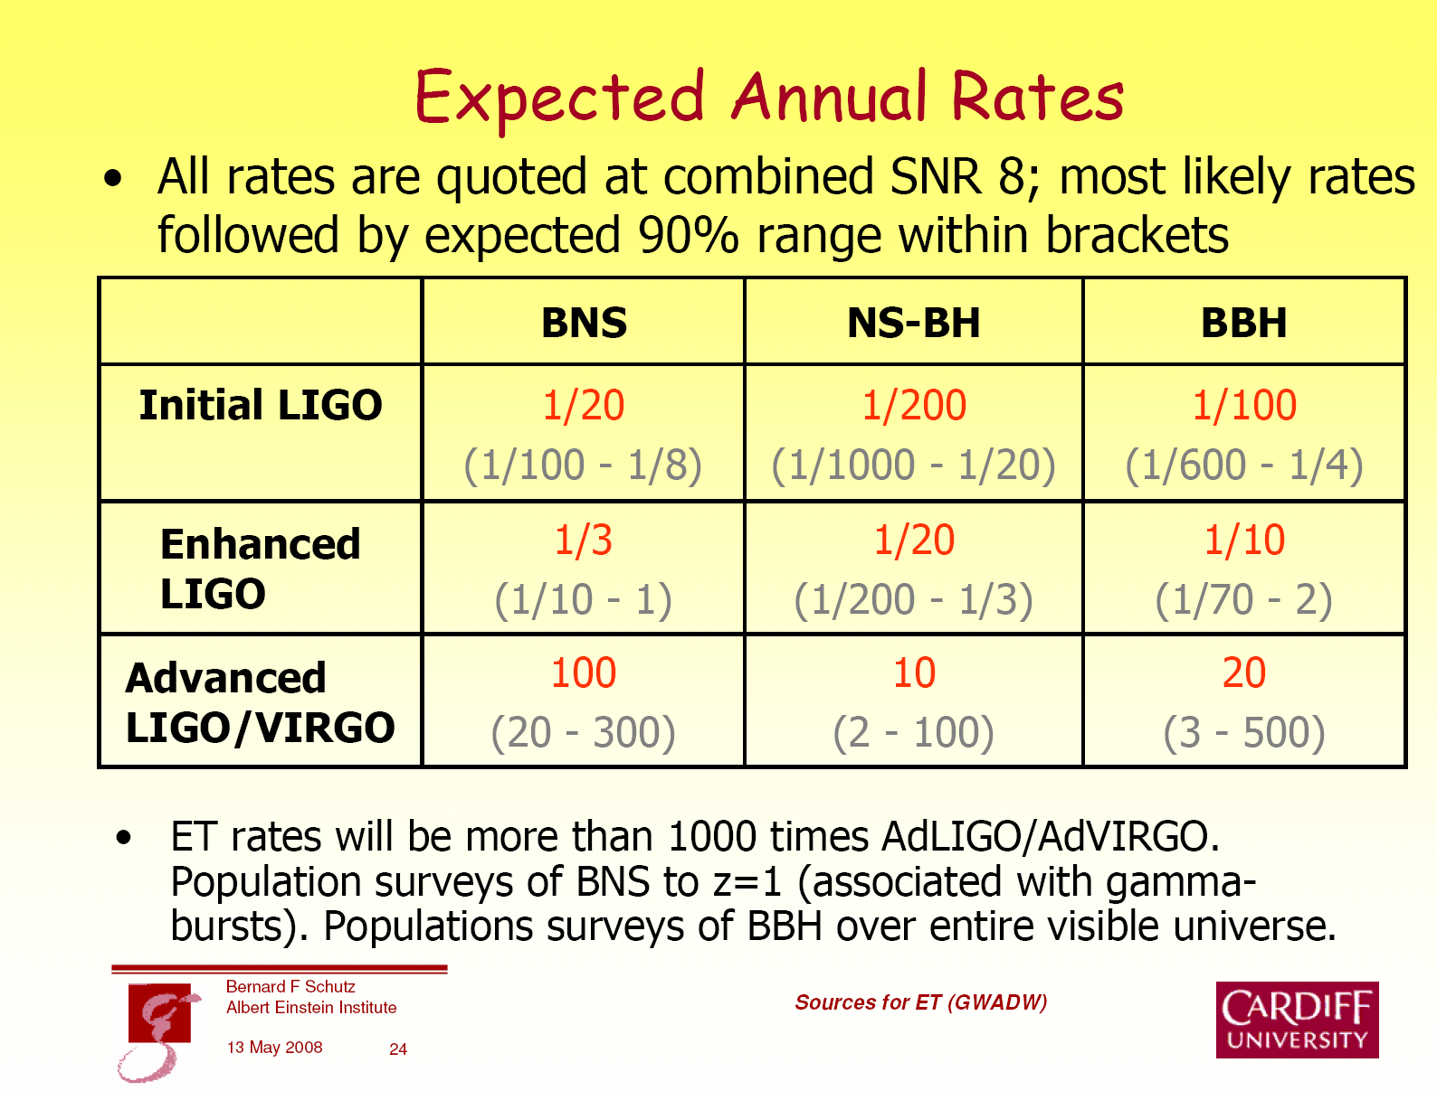

Slide 28
Questions
What is the mass distribution of compact objects, and how has this distribution evolved in time?
What is the mass range for neutron stars?
What is the lowest mass a BH can have?
What is the NS equation of state?

Slide 29
GW bremsstrahlung in galactic nuclei or globular clusters
Mass segregation → large number density of BHs in the center
GW signal to noise record for this mechanism
  Heavier BHs are detectable
  Larger distance
Distinct waveform
  Different signal from galactic nuclei and globular clusters
Event rates: 1—1000/yr for AdLIGO
[Kocsis, Gaspar Marka, 2006; O’Leary, Kocsis, Loeb, 2008]

Slide 30
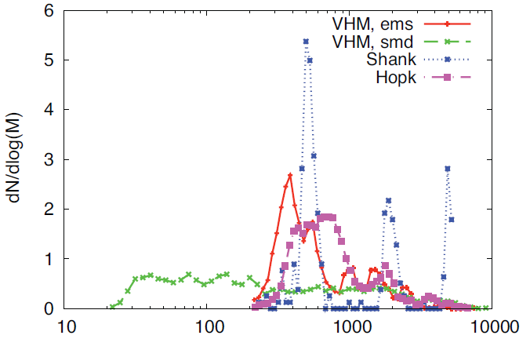
Pop III black holes
Determining the mass of the seeds from which galactic black holes grow is very important for understanding galaxy evolution.
ET can probe the first generation of black holes directly.
Astrophysics is somewhat uncertain, but if pop III BHs are light, an ET network could detect several events per year.
Sesana, Gair, Mandel, & Vecchio 2009

Slide 31
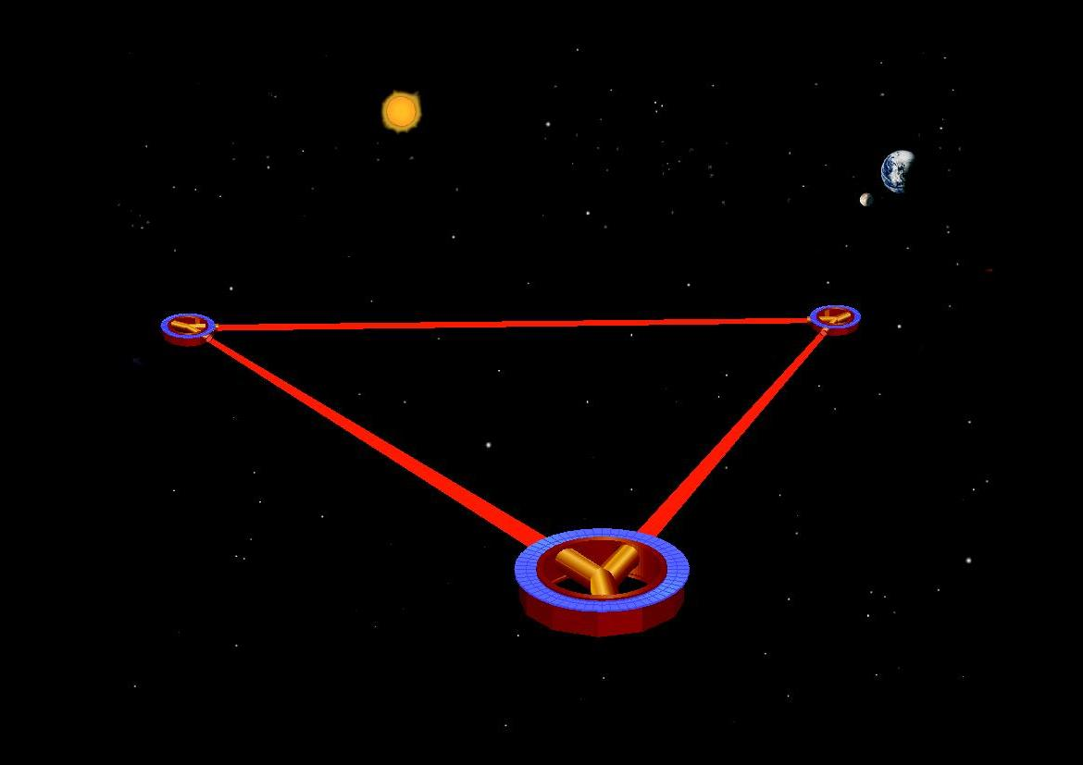
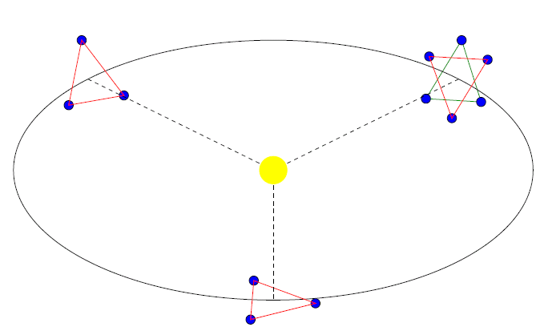
Gravity-wave Detectors – in Space
LISA 2018
DECIGO 2030
ALIAS 2025
BBO 2030
Notes:
There are also plans for the future. 5 million km armlength, measures much larger wavelengths, e.g. SMBHs as opposed to stellar mass compact objects.

Slide 32
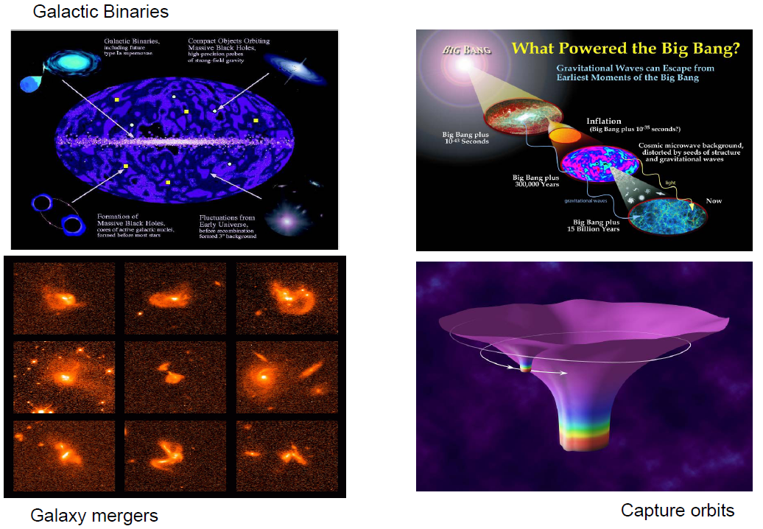
Sources for LISA

Slide 33
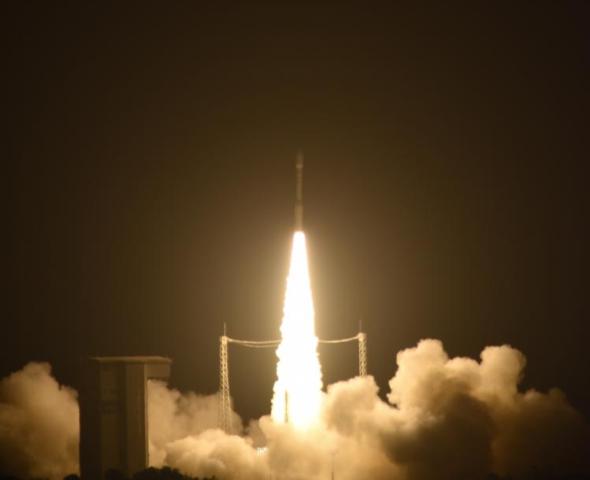
December 3, 2015
LISA pathfinder

Slide 34
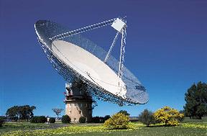
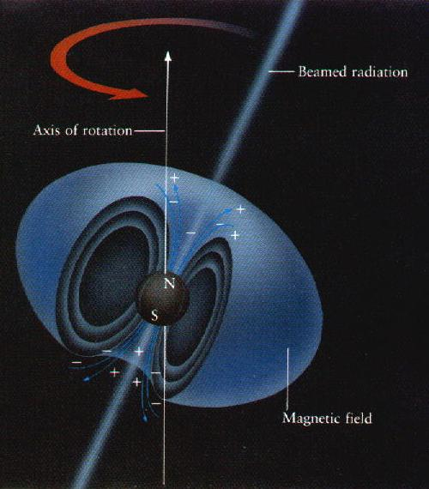
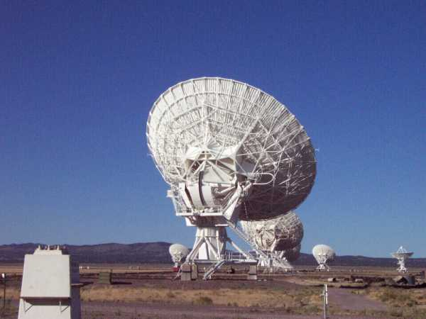

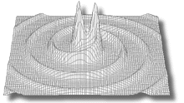
Pulsar Timing Arrays
Pulsar
Intensity
Earth
Time

Slide 35
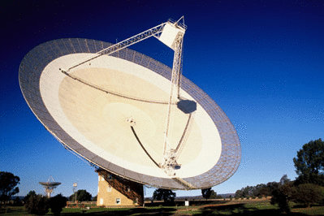
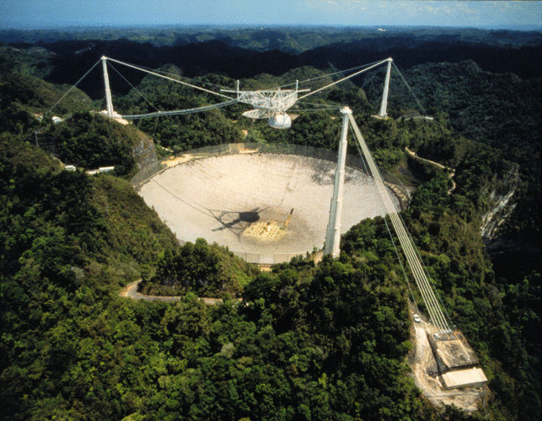
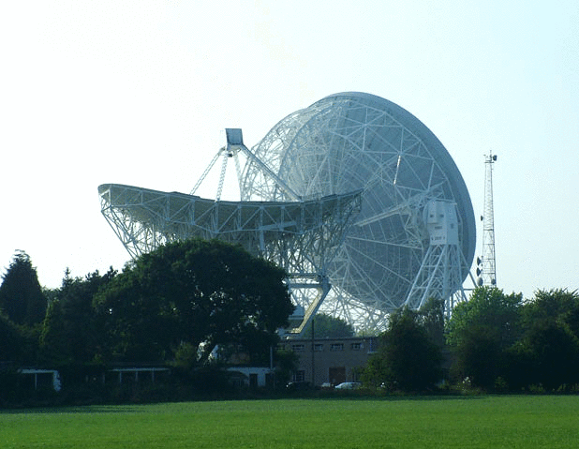
PPTA (Parkes pulsar timing array)‏
NanoGrav (north American nHz
observatory for gravitational waves)‏
LEAP (large European array
for pulsars)‏

Slide 36
Galaxies merge → black holes merge
Pulsar Timing Arrays detect them
How strong is the expected GW signal?

Slide 37
PTA sensitivity reached !
Shannon et al. (2015, Science)

Slide 44
Phinney’s Theorem (2001)

Slide 46
Phinney’s Theorem (2001)

Slide 47
Phinney’s Theorem (2001)

Slide 48
Phinney’s Theorem (2001)

Slide 50
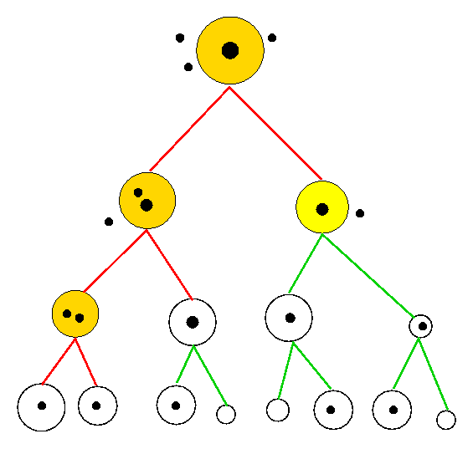
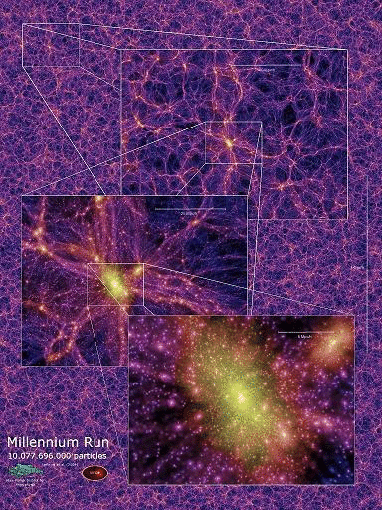
Merger history
SEMI-ANALYTICAL MERGER TREES (Haehnelt & Kaufmann 2000, Volonteri Haardt & Madau 2003; Wyithe & Loeb 2003; Koushiappas & Zentner 2006; Malbon et al. 2007; Yoo et al. 2007):
> Follow backwards the merger hierarchy by means of EPS Monte-Carlo merger tree
MILLENNIUM RUN (Springel et al 2005):
Sesana, Vecchio, Volonteri (2009)
> N-body numerical simulations of
the halo hierarchy
> Semi-analytical models for galaxy
formation and evolution
> We extract catalogues of merging
galaxies and we populate them with
sensible MBH prescriptions
The semi-analytic code follows the accretion and the dynamical history of BHs in every single branch of the tree‏

Slide 51
GW background for PTAs
How many massive BH binaries have ~0.1-10 year orbital time?
  Merger rate of galaxies
  Evolution of massive BH binaries during galaxy mergers
  → can gas effect the binaries?

Slide 52
Phinney’s Theorem (2001)

Slide 53
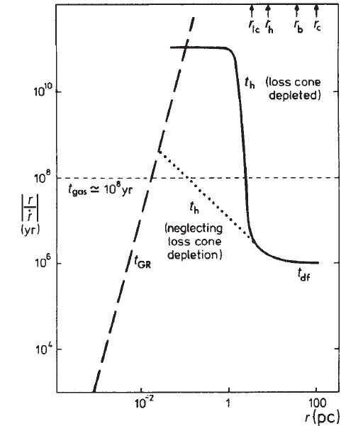
Evolution of binaries
Collisionless damping (~kpc; “dynamical friction”, “Landau damping”)
3-body encounters with stars (~ 1 pc)
Gas driven migration (~0.1 pc, “Type II migration”)
Gravitational waves (~0.01 pc)
Final parsec problem:
without gas driven migration or rapid loss cone refilling
binaries spend more than a Hubble time at ~ 0.1-1 pc
Begelman, Blandford, Rees (1980)

Slide 54
Evolution of binaries
Collisionless damping (~kpc; “dynamical friction”, “Landau damping”)
3-body encounters with stars (~ 1 pc)
Gas driven migration (~0.1 pc, “Type II migration”)
Gravitational waves (~0.01 pc)
Final parsec problem:
without gas driven migration or rapid loss cone refilling
binaries spend more than a Hubble time at ~ 0.1-1 pc
Begelman, Blandford, Rees (1980)
Number of binaries: enormous
in the pulsar timing array frequency band ???

Slide 55
Within the last pc
Thin gaseous disk
Disk aligns with binary plane (Bardeen & Peterson 1975, Ivanov et al. 1999)
Binary evacuates cavity (Artymowicz & Lubov 1994)
Viscous decay (“Type II migration”)
  Secondary dominated
  Disk dominated
Gravitational Wave driven evolution
  Cuadra et al. 2009;
  see also Ivanov et al. 1999; Armitage & Natarayan 2002, 2005; MacFadyen & Milosavljevic 2008;

Slide 56
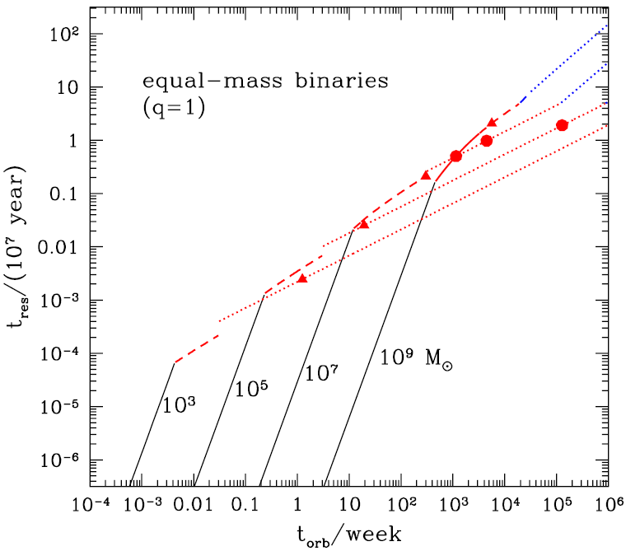
Within the last pc
  Residence Time
Thin gaseous disk
Disk aligns with binary plane (Bardeen & Peterson 1975, Ivanov et al. 1999)
Binary evacuates cavity (Artymowicz & Lubov 1994)
Viscous decay (“Type II migration”)
  Secondary dominated
  Disk dominated
Gravitational Wave driven evolution
  Haiman, Kocsis, Menou, 2009, ApJ, 700, 1952

Slide 57
Gravitational Waves for PTAs
Gas OFF
Gas ON
  Kocsis & Sesana (2010)
Contribution of individual sources
Unresolved background
Spectrum averaged over 1000 Monte Carlo realizations
Total signal

Slide 58
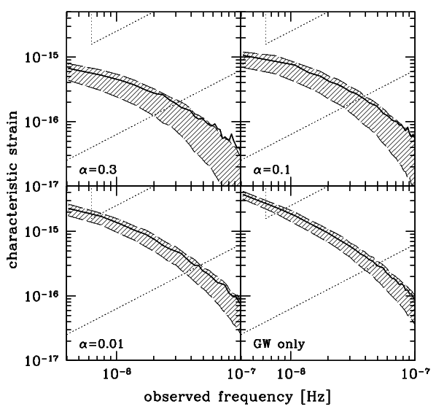
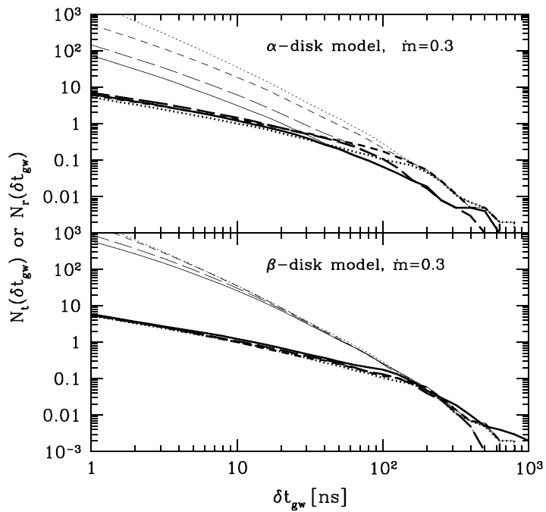
Number of resolvable sources basically unaffected
Stochastic background for α=0.3, 0.1, 0.01

Slide 59
Long term future of PTAs
Contribution of individual sources
Unresolved background
Spectrum averaged over 1000 Monte Carlo realizations
Total signal

Slide 60
Summary
Gas driven dynamics reduces the number of binaries in the PTA band
    Gas suppresses the stochastic background
      Factor 3-4 reduction at ~ 5 nHz for a stationary alpha-disk model with alpha = 0.3 and accretion rate m’ = 0.3 m’_{Edd}
    Individually resolvable sources unaffected:
      1-10 resolvable binaries after a 10 yr observation with 1-50ns timing precision

Slide 63
Coincident GW+ EM Observations
= Standard Sirens
GW
EM
Sky coordinates
Masses
Luminosity distance
Orbital elements
Spins
Identifying the counterpart
Sky coordinates
EM luminosity
Redshift
Spectrum,
Variability, etc.
Eddington Ratio
Eddington ratio
Cosmology (standard sirens)
BH & accretion
physics

Slide 64
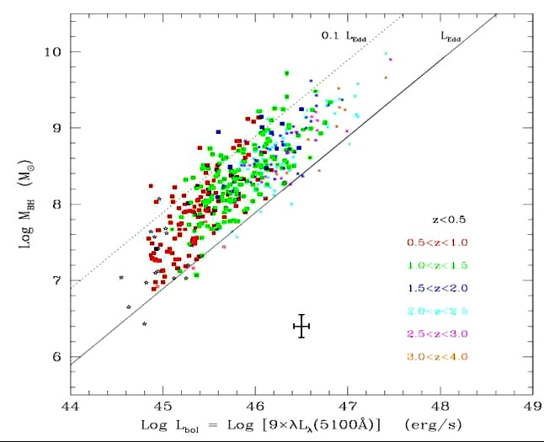
Eddington ratio
Presently only very uncertain 0.1 < L/L_Edd < 1
Standard sirens: % precision! (Kocsis et al. 2006)
SMBH Mass
Kollmeier et al. 2005
Luminosity

Slide 65
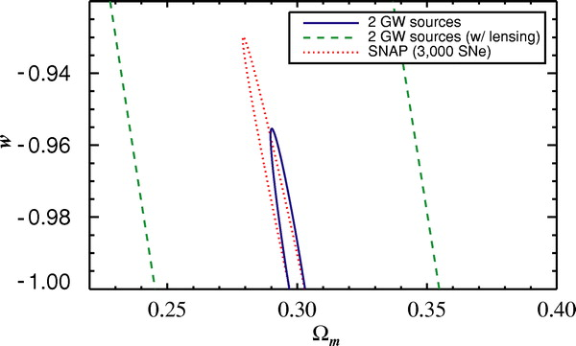
Cosmological parameters
Dark energy EoS
Holz & Hughes 2006
Dark matter density

Slide 66
Theory of gravity
Graviton mass (Kocsis, Haiman, & Menou 2008)
Extra dimensions (Dvali, Gabadadze, & Porrati 2000; Daffayet & Menou 2007)

Slide 67
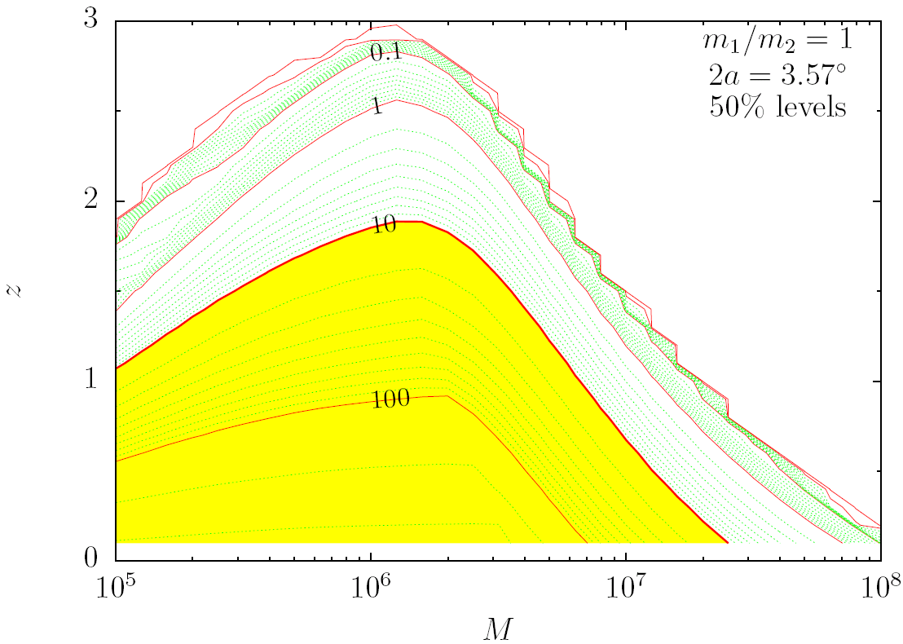
Advance Warning Time
[days before merger]
Search this volume for variability (~24-27 mag)
Kocsis et al., PRD 76, 022003 (2007)
Kocsis et al., PRD 76, 022003 (2007)
Kocsis et al., ApJ 684, 870 (2008)
Kocsis et al., astroph/0701629

Slide 68

Phases of mergers
1. Circumbinary disk – driven by gas 10⁴ – 500 R_{S}
Periodic accretion
Variability?
2. Final inspiral phase – Driven by gravitational waves 500 R_{S} – merger
Gravitational waves
Variability?
3. Postmerger phase – Transients
a.)
b.)
c.)
d.)
Mass loss → shocks
UV flare
GW kick → shocks
UV flare, IR afterglow
GW dissipation → IR flare
Accretion → X-rays

Slide 69
The BIG questions
Are they really black holes?
  (Kerr metric, vacuum, GR?, M, S)
What were the seeds? How many seeds?
  (stellar mass, Pop III 100-300 Msun, “superstars” >10⁴ Msun?)
  A seed in every z=15 dwarf? Or only one per present-day >L*?
What were the relative contributions of gas accretion, stellar capture and black hole mergers to their growth at each redshift?
LISA
LISA, JWST
LISA, all electromagnetic bands

